Slide 1

SOFTWARE ENGINEERING
UNIT-3
INTRODUCTION TO MAVEN, INSTALLATION AND CONFIGURATION
BY
Dr.K.Bhargavi
ASSOCIATE PROFESSOR
KMIT

Slide 2
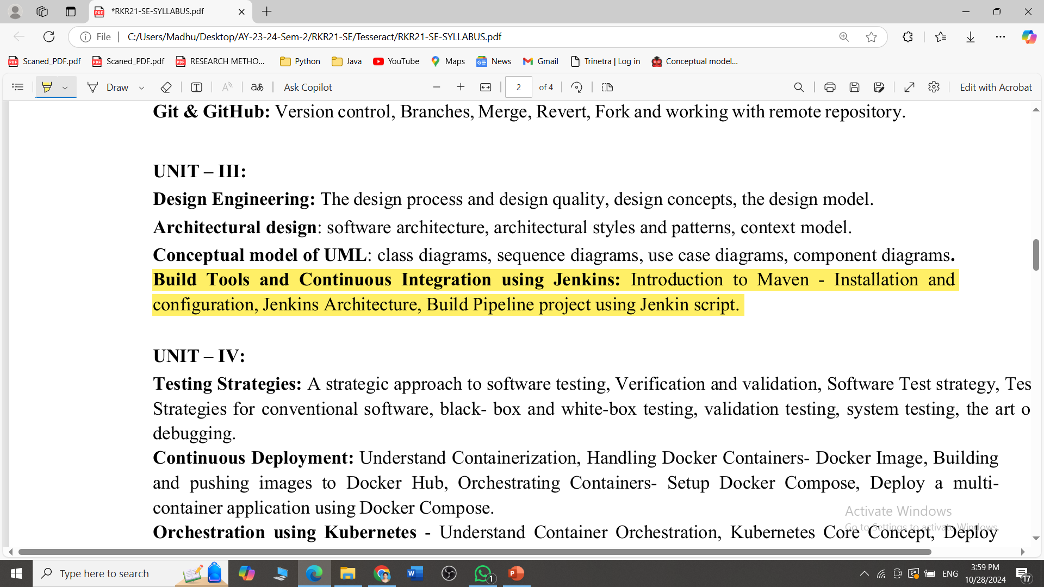

Slide 3
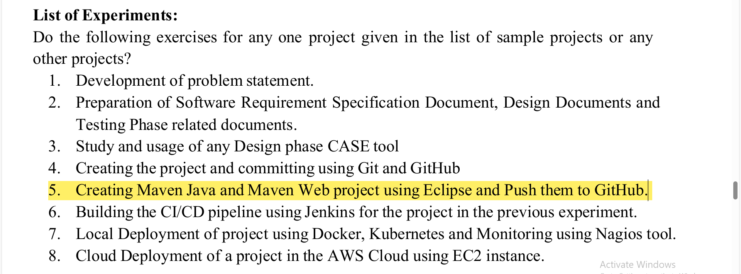

Slide 4
Introduction to Maven
What is Maven?
Maven is a tool that helps developers manage and build Java projects by automating repetitive tasks.
What is Building a Java Project?
Building involves compiling code, running tests, and packaging everything into a file that can be deployed or shared.
Why Use Maven?
Maven saves time by handling tasks like downloading libraries and creating final project files automatically.

Slide 5
Benefits of Using Maven
Without Maven:
Developers need to manually search, download, and add libraries to their project files.
With Maven:
By specifying libraries in the Maven configuration, Maven automatically downloads and sets them up for you.
Example:
For adding an Excel library, you only need to list it in Maven, and it will handle the download and integration.

Slide 6
The POM File (Project Object Model)
When using Maven, the POM.xml file is essential because it tells Maven everything it needs to know about the project.
It’s like a project guide that lists important details and instructions.
What is the POM File?
The POM.xml file is a configuration file that provides all the necessary information to build and manage the project.

Slide 7
The POM File (Project Object Model)
<project>
<groupId>com.example</groupId>
<artifactId>email-project</artifactId>
<version>1.0</version>
<dependencies>
<dependency>
<groupId>javax.mail</groupId>
<artifactId>mail</artifactId>
<version>1.4</version>
</dependency>
</dependencies>
</project>
Here, the <dependency> tag tells Maven to download the specified email library automatically.

Slide 8
The POM File (Project Object Model)
What’s Inside the POM File?
groupId: The organization or group that owns the project.
artifactId: The name of the project.
version: The project’s version (e.g., 1.0).
dependencies: Lists external libraries the project needs.

Slide 9
Maven Build Lifecycle
The build lifecycle is a series of steps Maven follows to compile, test, and package the project.
Lifecycle Phases with Commands:
Clean: Clears out previous build files.
Command: mvn clean
Compile: Compiles the source code into bytecode.
Command: mvn compile
Test: Runs tests on the code.
Command: mvn test

Slide 10
Maven Build Lifecycle
Lifecycle Phases with Commands:
Package: Bundles everything into a single deployable file (JAR or WAR).
Command: mvn package
Install: Adds the package to the local repository for future use.
Command: mvn install
Deploy: Publishes the package to a remote repository for sharing with others.
Command: mvn deploy

Slide 11
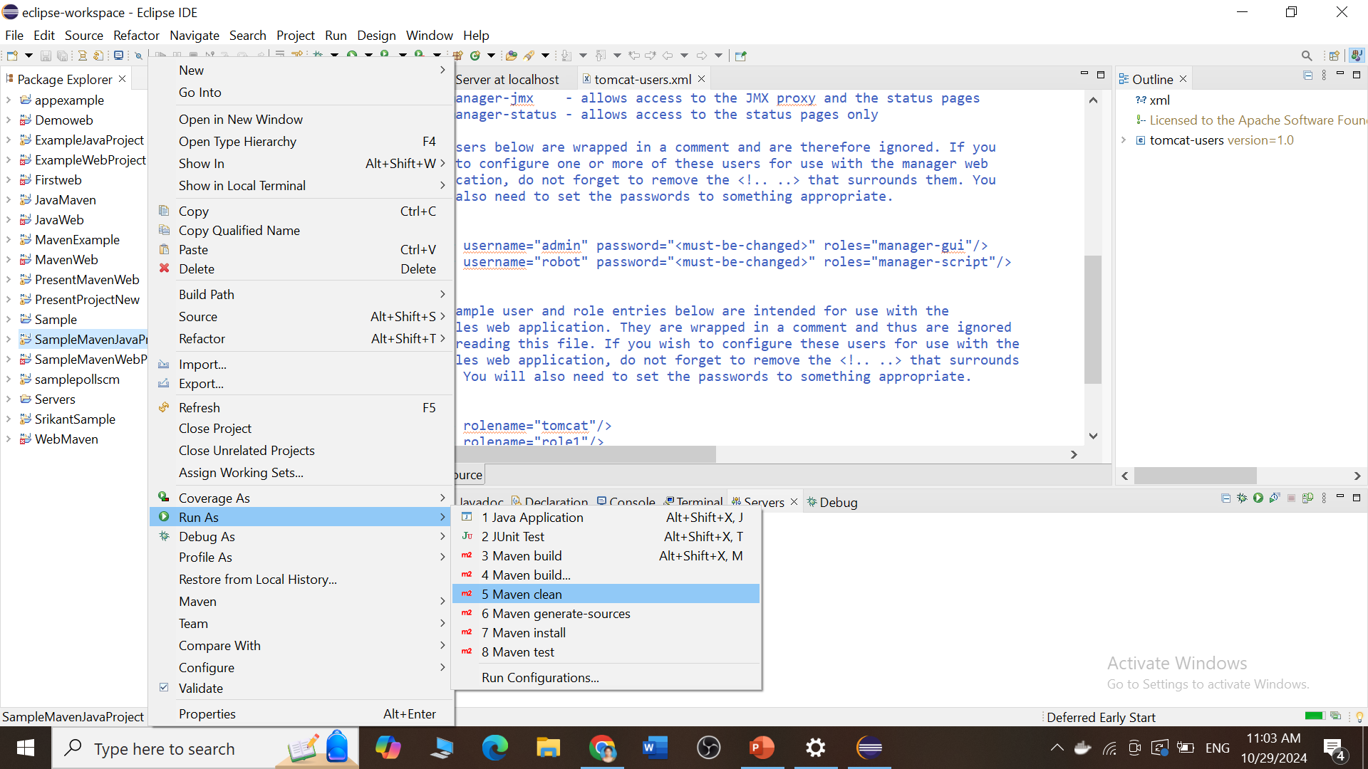
Maven Build Lifecycle

Slide 12
Maven Build Lifecycle
Lifecycle Phases with Commands:
Clean
Compile
Test
Package
Install
Deploy

Slide 13
Understanding JAR, WAR, and Target Files
In the package phase, Maven produces files that vary depending on project type:
What is a JAR File?
A JAR (Java ARchive) file is a packaged file format that includes all compiled Java code and resources for standalone applications.
Example: If you create a calculator application, Maven packages it into a JAR file for easy distribution and use on other systems.

Slide 14
Understanding JAR, WAR, and Target Files
What is a WAR File?
A WAR (Web Application Archive) file is a package format for web applications, containing all files needed to run on a web server.
Example: For an online bookstore, Maven packages all web files and code into a WAR file for deployment on a server.

Slide 15
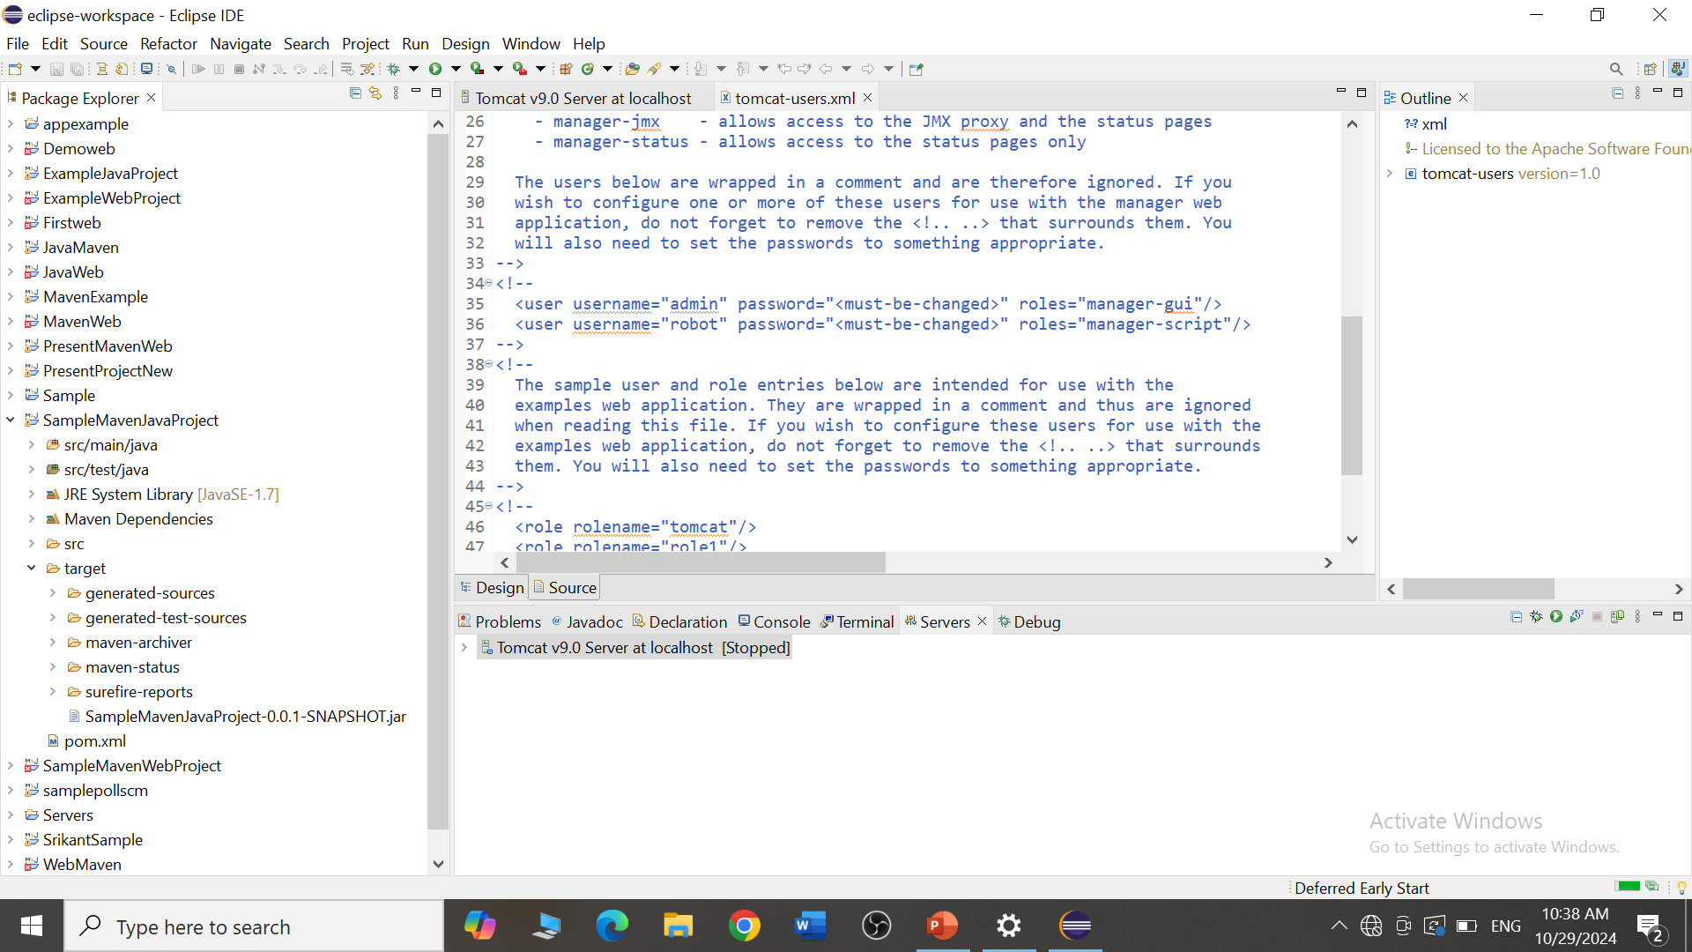
Understanding JAR, WAR, and Target Files
What is the Target Folder?
The target folder is where Maven places all output files, like JAR and WAR files, generated during the build process.

Slide 16
Maven Repositories
A repository is a storage location for libraries (dependencies) that Maven needs for building projects.
Types of Repositories:
Local Repository: A repository stored on your computer, which Maven checks first for required libraries.
Central Repository: An online repository managed by the Maven community, available to everyone.
Remote Repository: A specific online repository for additional or custom libraries not found in the central repository.

Slide 17
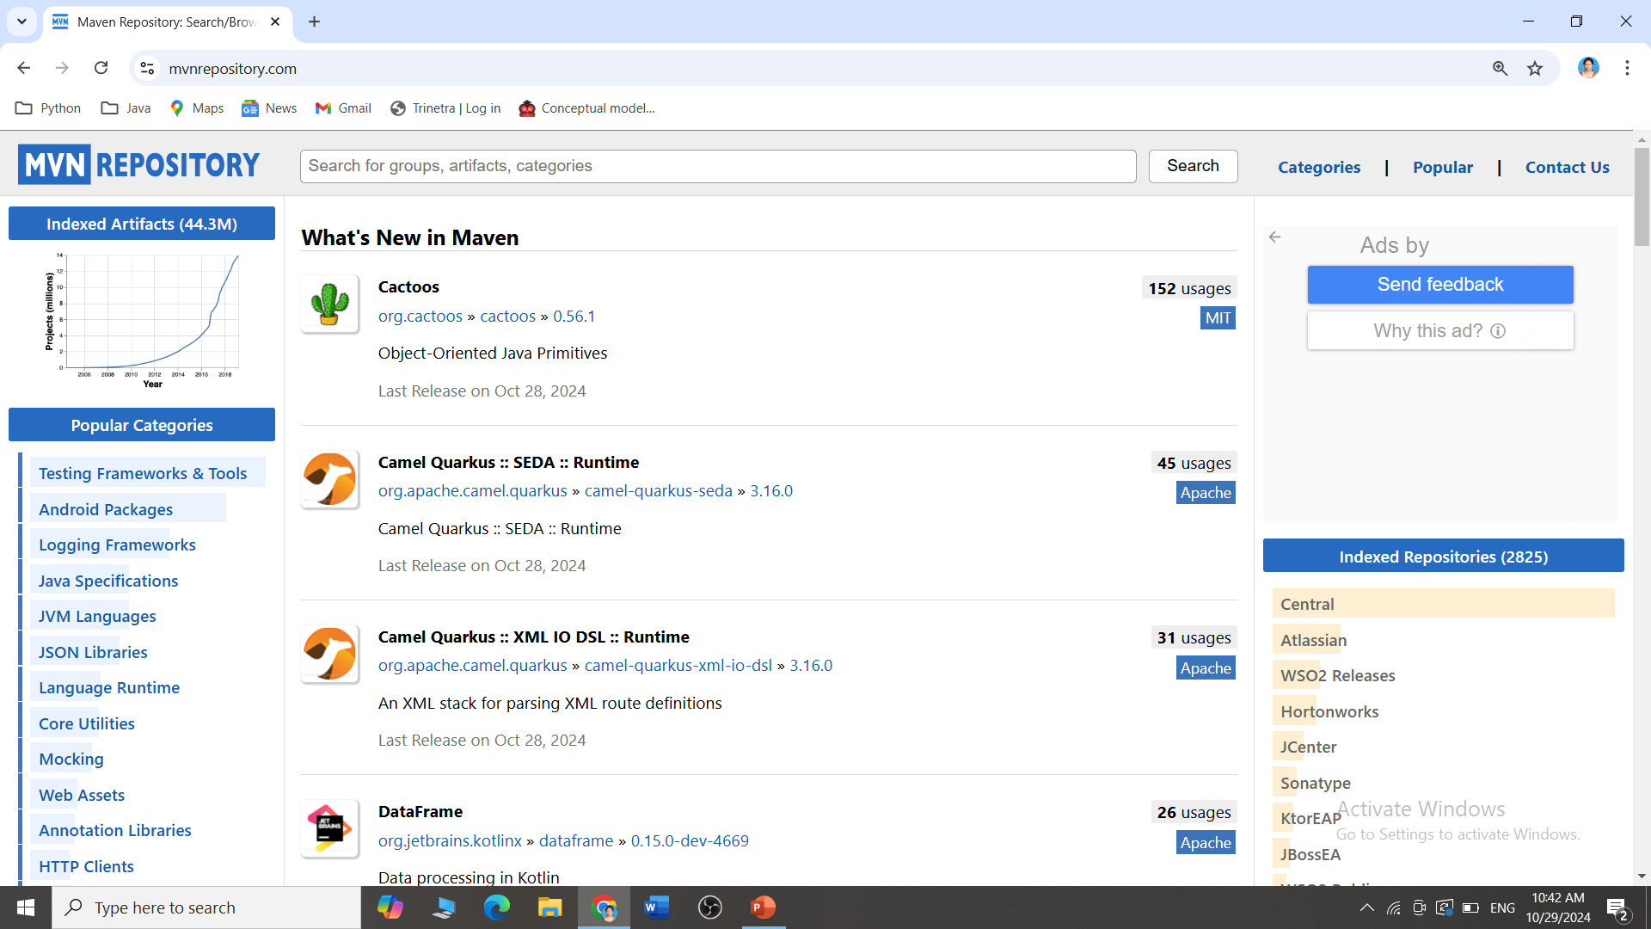
Maven Repositories

Slide 18
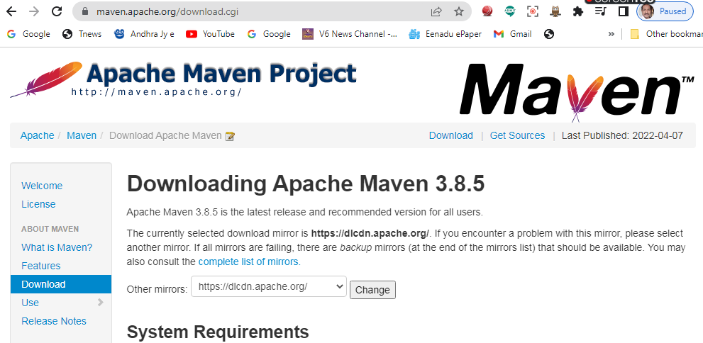
Installing and Setting Up Maven
Download Maven: Download the latest version from the Apache website.
Extract Files: Unzip the files into a chosen directory

Slide 19
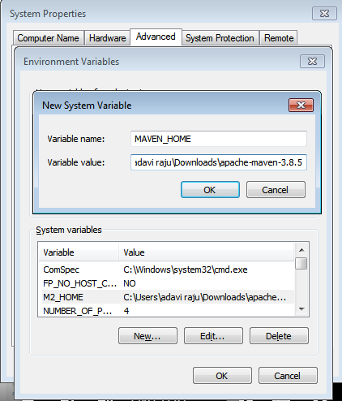
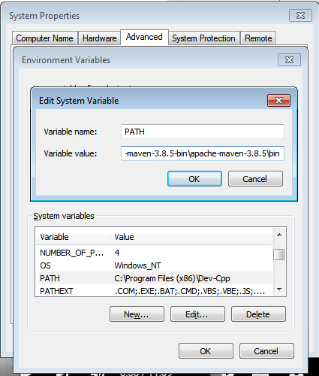
Installing and Setting Up Maven
Set Environment Variables:
MAVEN_HOME: Path to your Maven installation.
Add to PATH: This allows running Maven commands from any directory.

Slide 20
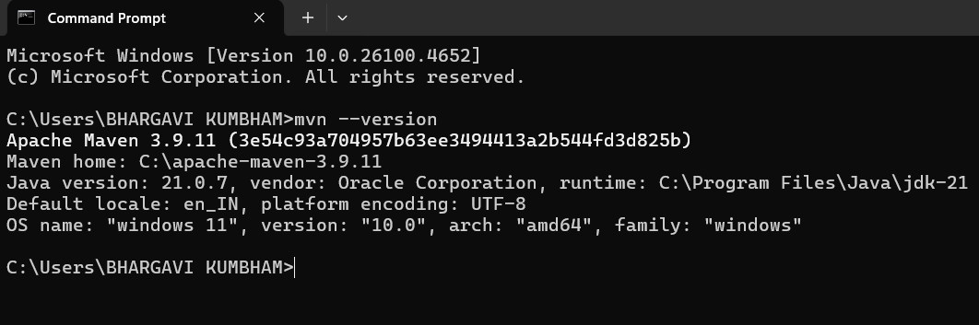
Installing and Setting Up Maven
Verify Installation: Run mvn -version in your terminal to confirm that Maven is installed correctly.

